Slide 1

Strategic Expansion of Oreo Cookies into Nigeria To the Board of Directors, Mondelez International
Prepared by: Olivier Takuete T.

Slide 2
TABLE OF CONTENT
Executive Summary………………………………………………………...…. 1
Company Profile……………………………………………………………..... 2
Product overview……………………………………………..…………….…. 3
Target Market overview…………………………….…………………….…….4
Sales & Marketing Operation …..…………….…………….………………….5
Revenue…………………………………………………………………………6
Production and Human Resource Expenses………………………………………………..……………………….7
Conclusions …………………………………………………………..…………8
Appendix………………………………………………………………………...9

Slide 3
EXECUTIVE SUMMARY
Mondelez International is strategically expanding its Oreo brand into Nigeria, capitalizing on the country's growing middle class, youthful population, and increasing demand for packaged snacks. With the Nigerian snack market growing at 8% annually, this move positions Oreo to become a market leader while leveraging Mondelez’s existing infrastructure through Cadbury Nigeria Plc.
The company’s expansion strategy focuses on localized production, ensuring cost efficiency and compliance with Nigeria’s agricultural policies. Oreo will be introduced in affordable, single-serve packs priced at ₦250 ($0.50), catering to price-sensitive consumers while maintaining its premium global appeal.
From an ROI (Return on Investment) perspective, financial projections indicate a 10% annual revenue growth, increasing from $10 million in 2024 to $12.1 million by 2026. Despite initial high production and marketing costs, cost optimization strategies, such as local sourcing and streamlined distribution, will ensure long-term profitability.

Slide 4
COMPANY PROFILE:
Mondelez International is a multinational food and beverage conglomerate operating in over 150 countries, with headquarters in Chicago, Illinois, USA.
The company generated $36 billion in revenue in 2023, emphasizing its commitment to innovation, quality, and consumer satisfaction.
Mondelez prioritizes sustainability, ethical sourcing, and community impact through initiatives like the Cocoa Life program, which supports sustainable cocoa farming.
Nigeria presents a high-growth market with an increasing demand for trusted, high-quality snacks. Which Is an ideal market for Oreo Cookies.

Slide 5
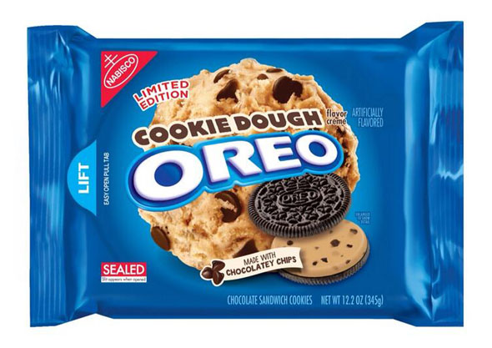
PRODUCT OVERVIEW:
Product Adaptation:
Introduction of Spiced Cocoa Oreo, infused popular Nigerian fruits and spices eg .,Tamarinds, papaya, ginger,nutmeg, and soursop with Nigerian-grown cocoa and local spices & fruits to appeal to local taste.
Single-serve packs priced at ₦250 ($0.50), ensuring affordability.
This Photo by Unknown Author is licensed under CC BY-NC-ND

Slide 6
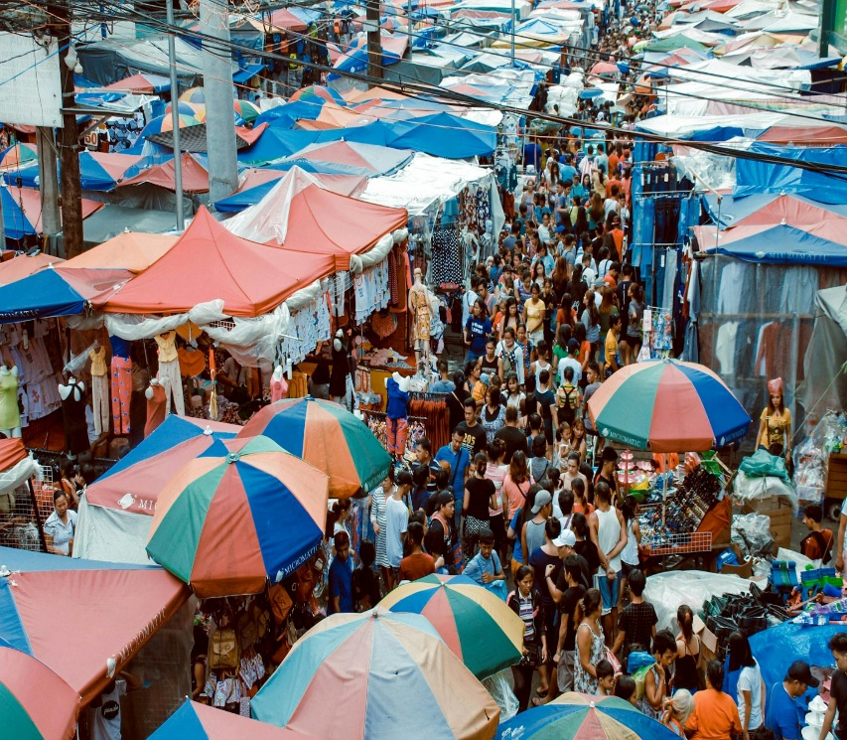
Economic Indicators Nigeria stands out as a viable target market for Mondelez products, particularly due to her economic strength, demographic-strategic marketing outlets and growing youthful population. Nigeria: GDP $477 billion USD according to Worldometer (2023), while its GNP is reported at $355.8 billion USD based on recent data from CEIC(2023), , Africa’s largest economy, driven by oil and a rising tech sector. She has the largest population in Africa (over 220 million), providing a vast consumer base.
TARGET MARKET OVERVIEW
Illustration of a highly populous Nigerian Market

Slide 7
TARGET MARKET OVERVIEW
Political & Economic challenges and Mitigation
Import Costs: High tariffs on imported goods incentivize local production. Partnering with Nigerian cocoa farmers reduces expenses and aligns with the government’s push for agricultural investment. Currency Volatility: The Naira’s instability necessitates hedging strategies and local sourcing to mitigate exchange rate risks. Infrastructural limitations: Unreliable power and logistics require investments in solar-powered facilities and partnerships with local delivery networks. Competition: Local brands like Noreos thrive on affordability. Oreo’s premium image can coexist by emphasizing quality (e.g., “Made in Nigeria”) while keeping prices accessible.

Slide 8
OPERATION STRATEGY
Mondelez International’s entry into Nigeria with Oreo cookies operates within a Brownfield market framework, leveraging existing (Cadbury Nigeria Plc)infrastructure, consumer familiarity with packaged snacks, and established distribution networks.
Production Strategy
Partner with Nigerian cocoa farmers to obtain raw materials locally, This reduces,cost of production, import duties and aligns with “Made in Nigeria” branding.
Establish a local packaging facility in Lagos to assemble and package Oreo cookies, cutting logistics costs and enabling faster market responsiveness.
This approach balances brownfield advantages (utilizing existing agricultural and logistical frameworks) with incremental investments to optimize costs.

Slide 9
SALES & MARKETING OPERATION
Mondelez will employ a Blue Ocean Strategy to carve uncontested demand for Oreo:
Cultural influence: Introduce flavors like Oreo Peanut Butter and Spiced Cocoa, resonating with popular Nigerian culinary tastes.
Social Media : Collaborate with Afrobeats artists and TikTok influencers to launch viral challenges (e.g., “#OreoTeaDipChallenge).
Community Engagement: Sponsor local football leagues and street dance competitions.
Sales & Distribution Strategy
Nigeria’s retail landscape is dominated by informal channels, necessitating a dual approach:
Modern Retail: Secure shelf space in supermarkets like Shoprite and Spar in Lagos and Abuja.
Informal Networks: Partner with roadside kiosks, market vendors, and mobile hawkers to distribute affordable mini-packs (3-cookie packs ).

Slide 10
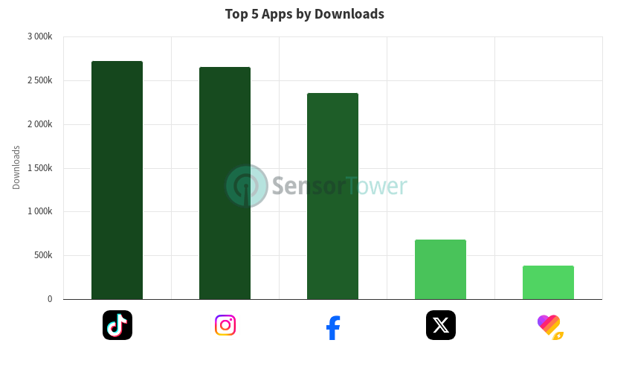
PERFORMANCE METRICS DATA SHOWING THE MOST USED SOCIAL MEDIA APPS IN NIGERIA
The data, sourced from Sensor Tower

Slide 11
SALES & MARKETING OPERATION
Brownfield Advantage & Execution
Mondelez International will capitalize on its existing Cadbury PLC Nigeria to introduce Oreo into the market. This approach minimizes costs, accelerates market entry, and reduces operational risks by using pre-established resources.
Execution Strategy
Utilizing Existing Mondelez Structures
Cadbury Nigeria Plc: Mondelez's subsidiary, known for its strong manufacturing and distribution network, will facilitate Oreo production and supply.
Established Retail Channels: Oreo will leverage Mondelez's partnerships with supermarkets, convenience stores, and informal trade markets.
Warehousing & Logistics Hubs: Mondelez’s distribution centers will ensure smooth nationwide product availability.
Localized Production & Sourcing
Sourcing local ingredients where feasible to align with market pricing.

Slide 12
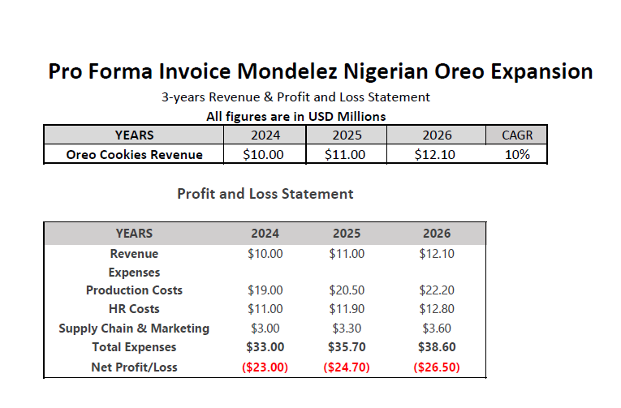
Financial Assumptions
Revenue: Oreo Cookies sales are projected to grow 10% annually from 2024 to 2026.
Production Costs: Annual increases in cocoa (3%), sugar (5% global price hike + 10% import duty), and packaging (exchange rate risks).
HR Expenses: Local salaries adjusted for 5% annual inflation, expatriate costs include housing and relocation allowances.
Supply Chain & Marketing: Import duties rise 8% annually, digital marketing grows 10% yearly.
Facility Costs: Rent and maintenance align with Nigerian real estate affordability and safety compliance.

Slide 13
REVENUE
The projected revenue for Oreo in Nigeria is set to grow from $10 million in 2024 to $12.1 million by 2026, reflecting a 10% compound annual growth rate (CAGR).
Contingency Plan: Ensuring a Sustainable Expansion
Cost Optimization Strategy –Mondelez will explore local ingredient sourcing and contract manufacturing to reduce these expenses.
Market Adaptation – If sales underperform, the company will introduce smaller, more affordable pack sizes.
Risk Management – To combat currency fluctuations and inflation, pricing strategies will be reviewed quarterly, with a hedging plan in place for key raw materials.

Slide 14
PRODUCTION EXPENSE
2. Production Strategy & Costs (2024-2026)
Manufacturing Locations: Cadbury Plc Plants in Lagos and Abuja will handle production.
Cocoa will be sourced locally to support Nigerian farmers and reduce costs.
Sugar and packaging materials will be imported, subject to price fluctuations.
3.Facility & Utility Costs:
Investments in rents will be minimized due to using Cadbury Nigeria’s plant and we will need backup power generators due to Nigeria’s unstable electricity supply.
4.Technology & Equipment:
Advanced machinery and IT systems will be deployed to maintain high production efficiency and quality control.

Slide 15
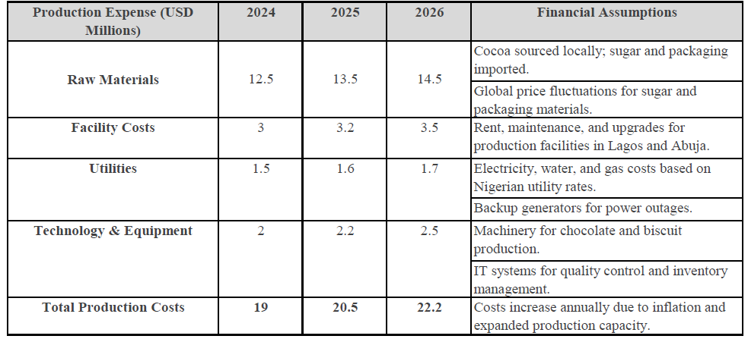
PRODUCTION EXPENSE INVOICE
3-year Production Expense Invoice

Slide 16
HUMAN RESOURCE EXPENSES
Workforce Composition:
Local workers for production to support employment and cost efficiency.
Expatriates in managerial and technical roles to maintain global standards.
Sales & Marketing Strategy:
Local teams will expand distribution to informal markets and small retailers.
Marketing efforts will focus on brand awareness and consumer engagement.
Administrative & Compliance:
Offices in Lagos and Abuja will manage daily operations and ensure adherence to labor laws.

Slide 17
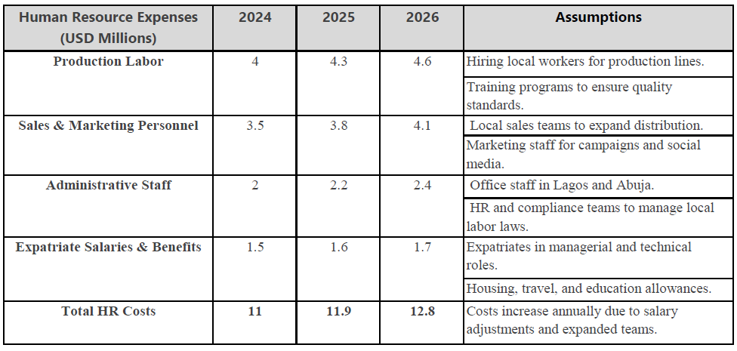
HUMAN RESOURCE EXPENSES
3-years Staffing Expenses

Slide 18
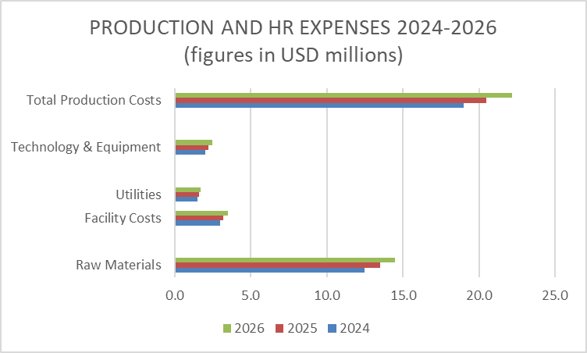

Slide 19
CONCLUSION STATEMENT
Mondelez strategic expansion of Oreo into Nigeria presents an opportunity to capitalize on the country’s untapped growth potential. By leveraging localized production (via Cadbury Chocolate Nigeria Plc), culturally resonant innovations (e.g., Spiced Cocoa Oreo), and cost-optimized distribution (dual focus on modern retail and informal markets), Oreo is positioned to carve a competitive niche in Nigeria’s $477 billion economy.
While challenges like import duties, infrastructure gaps, and competition persist, Mondelez’s phased approach—local partnerships, and data-driven marketing—ensures success.
Final Recommendation: Approve the Oreo Nigeria expansion plan to secure first-mover advantage, drive long-term profitability, and establish Oreo as a beloved, culturally relevant brand in a high-potential market.

Slide 20
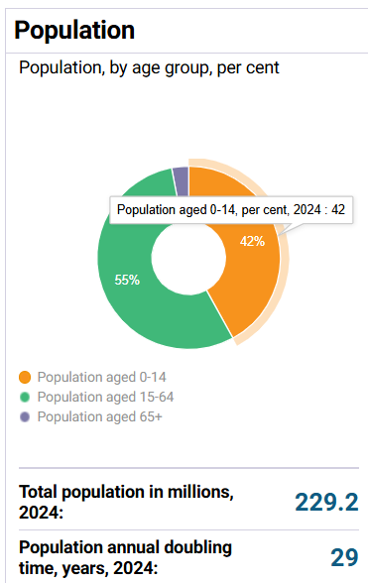
Appendix
Nigeria’s Population data set according to the United Nations Population fund.

Slide 21
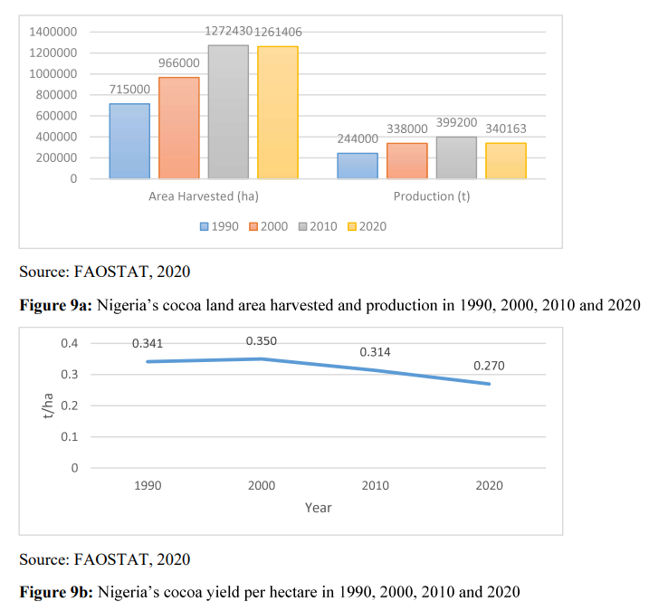
Food and Agriculture Organization (FAO)Statistics on Cocoa Production in Nigeria

Slide 22

NIGERIA HERE WE COME
This Photo by Unknown Author is licensed under CC BY

